Slide 1
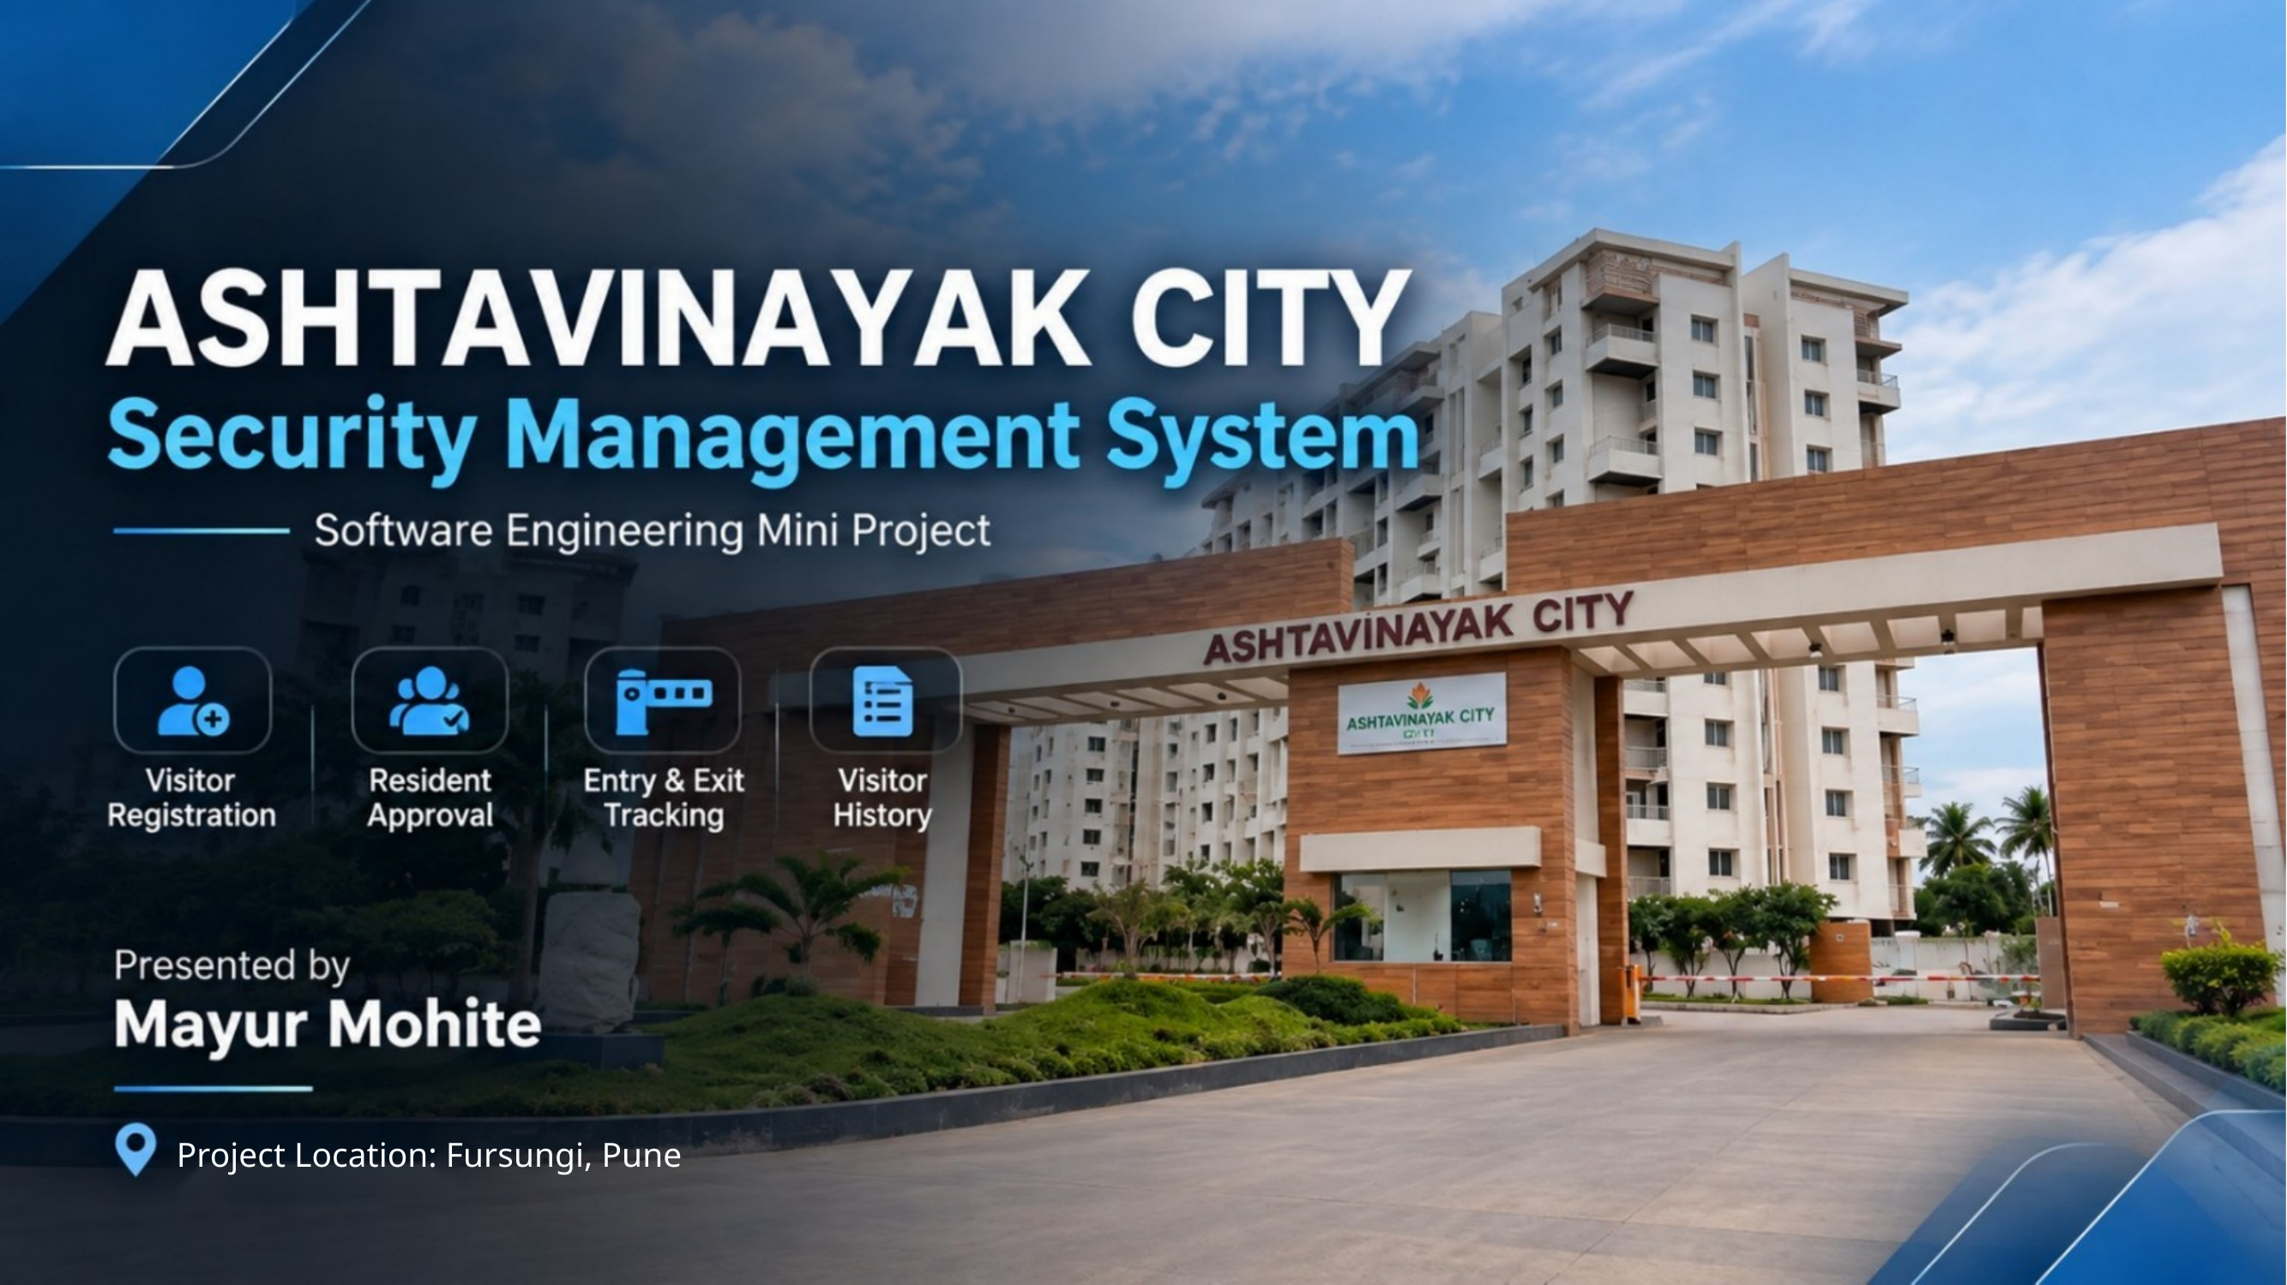

Slide 2
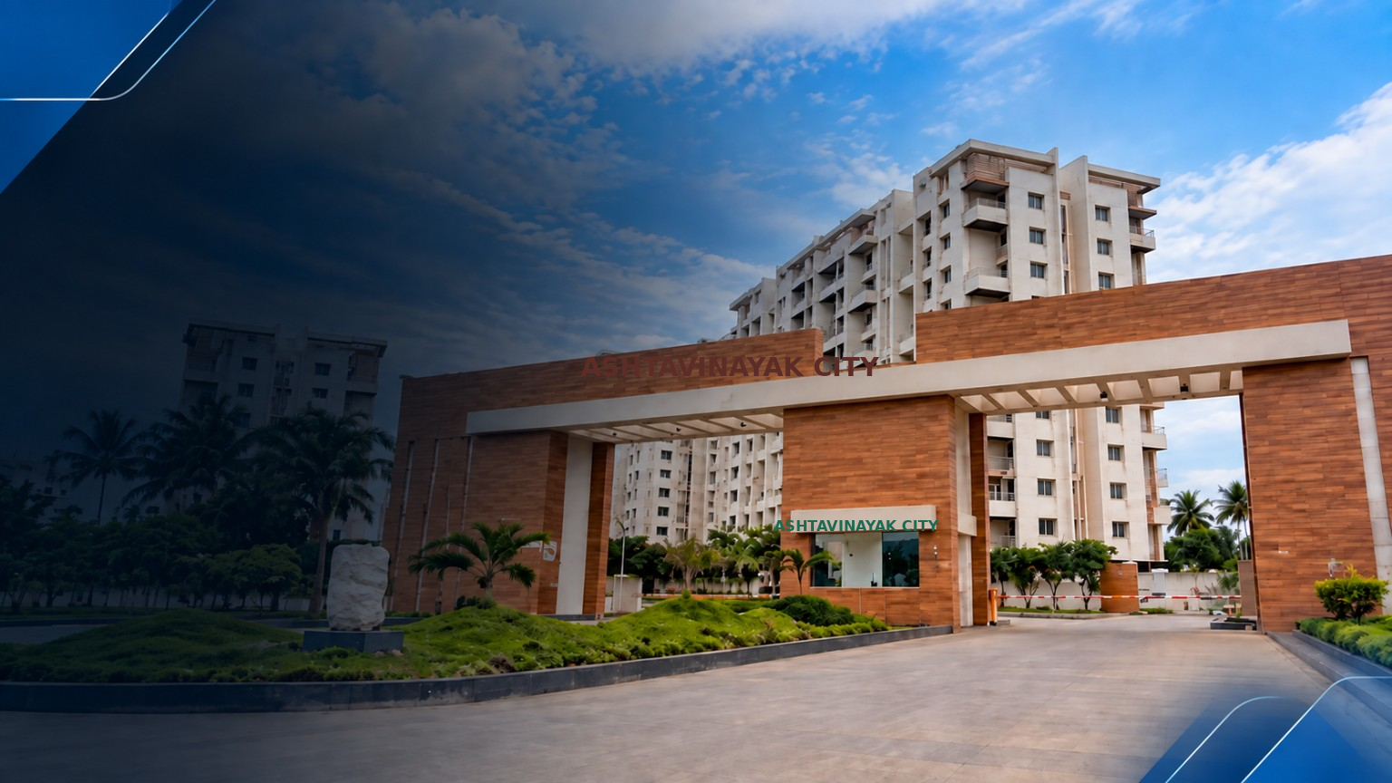
Introduction
A web-based visitor management solution for residential society security
Presentation Opening
Hello everyone, my name is Mayur Mohite.
Today I am going to demonstrate my Software Engineering Mini Project, Ashtavinayak City Security Management System.
It is a web-based visitor management system developed for residential society security management.
Focus: Visitor Registration • Resident Approval • Entry & Exit Tracking

Slide 3
Problem Statement
Why a centralized digital visitor management system is needed
Traditional Manual System
Proposed Solution
Visitor details are maintained manually.
Approval records may be difficult to track.
Entry and exit information is recorded manually.
Managing and retrieving visitor history can be difficult.
The project provides a centralized digital system for managing the complete visitor entry and exit process.
It brings visitor registration, resident approval, security tracking and visitor history into one web-based system.

Slide 4
Technologies Used
Core technologies and platform components used in the project
Python
Flask
SQLite
Backend programming
Web application framework
Database management
HTML
CSS
Telegram Bot API
Web page structure
User interface styling
Resident approval communication
Next: Live practical demonstration of the system on the laptop.

